Slide 1
Week 5 Project

Slide 2
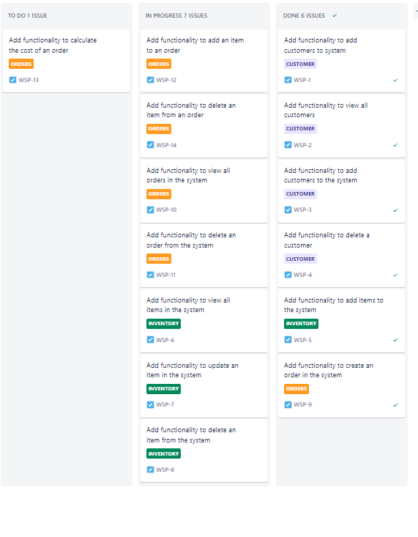
Jira

Slide 3
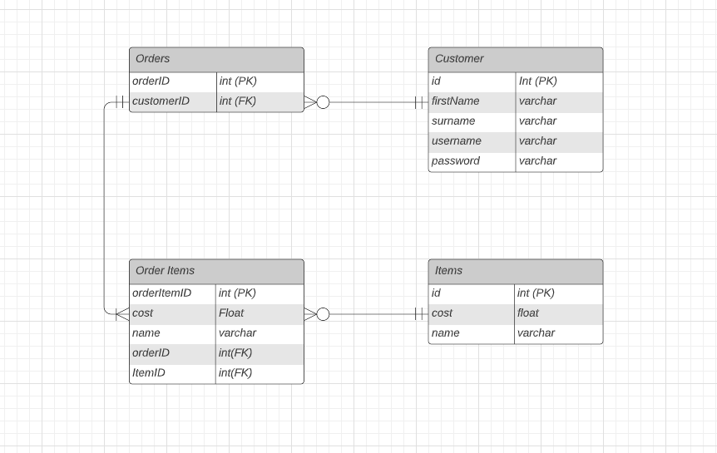
Original ERD

Slide 4
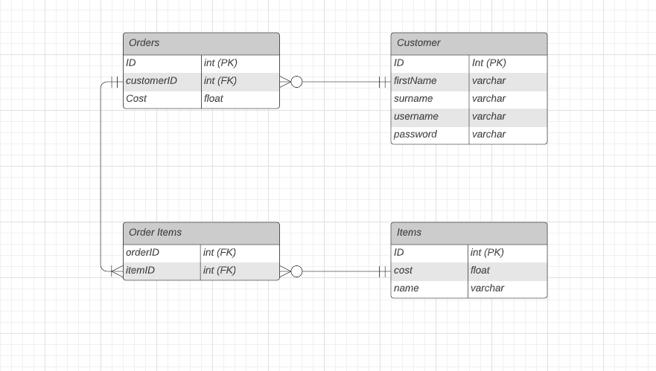
Final ERD

Slide 5
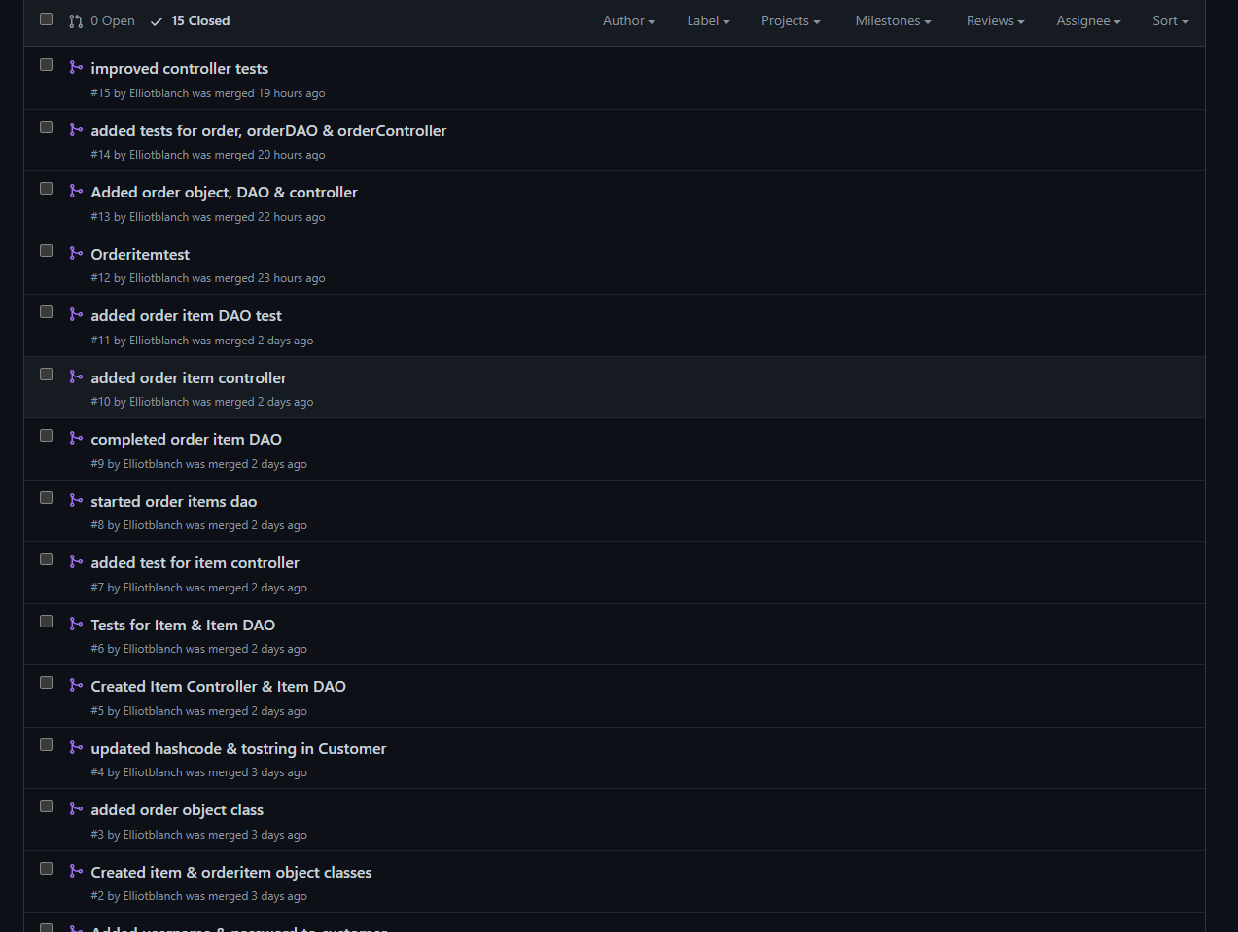
Pull Requests

Slide 6
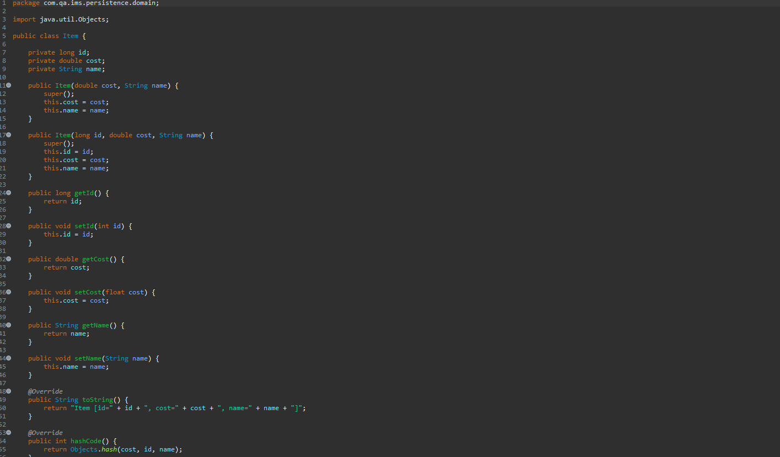
Object Creation

Slide 7
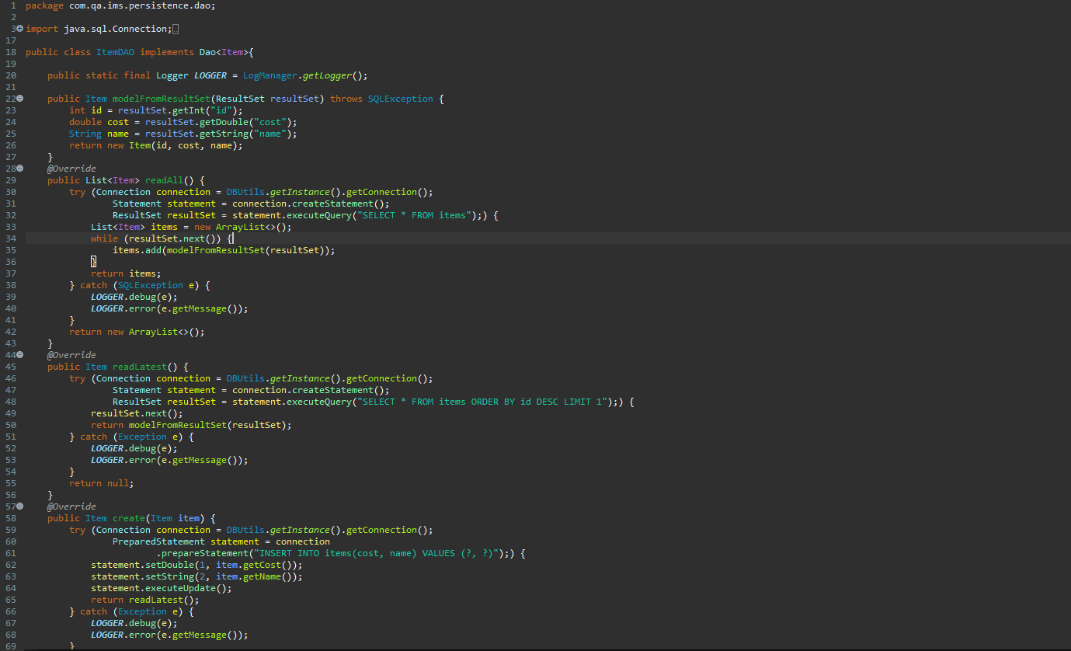
DAO Class

Slide 8
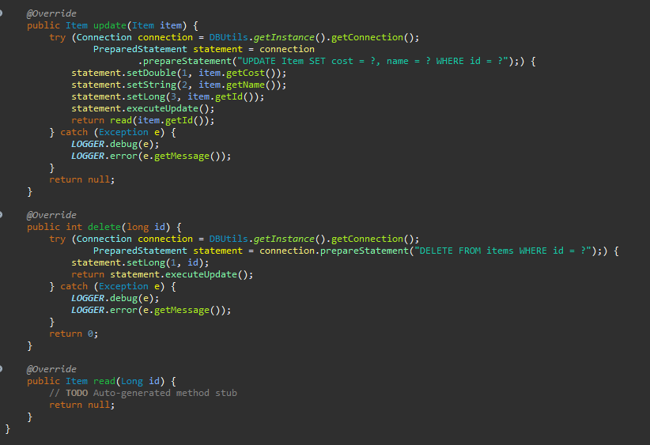
DAO Class

Slide 9
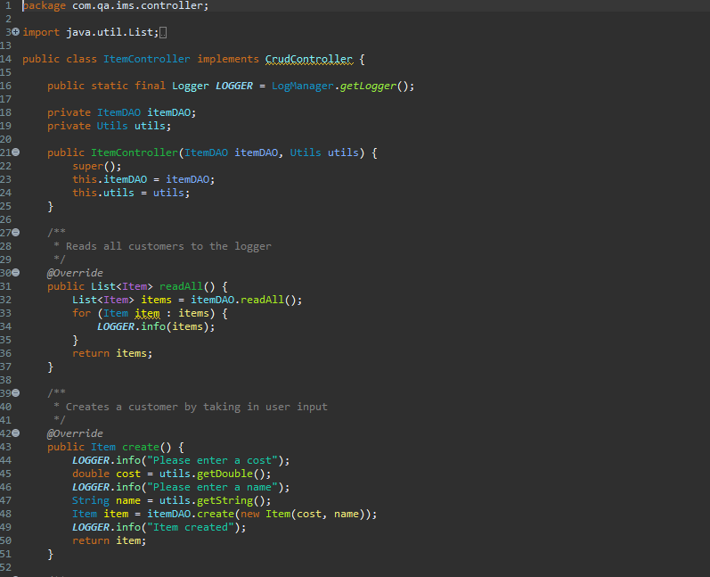
Controller

Slide 10
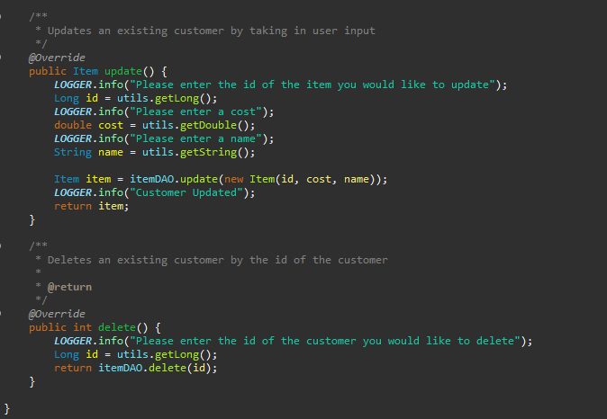
Controller

Slide 11
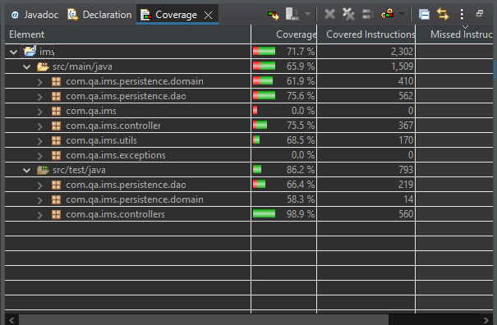
Testing - Coverage

Slide 12
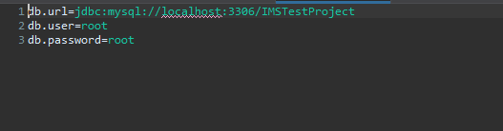
Testing - DB

Slide 13
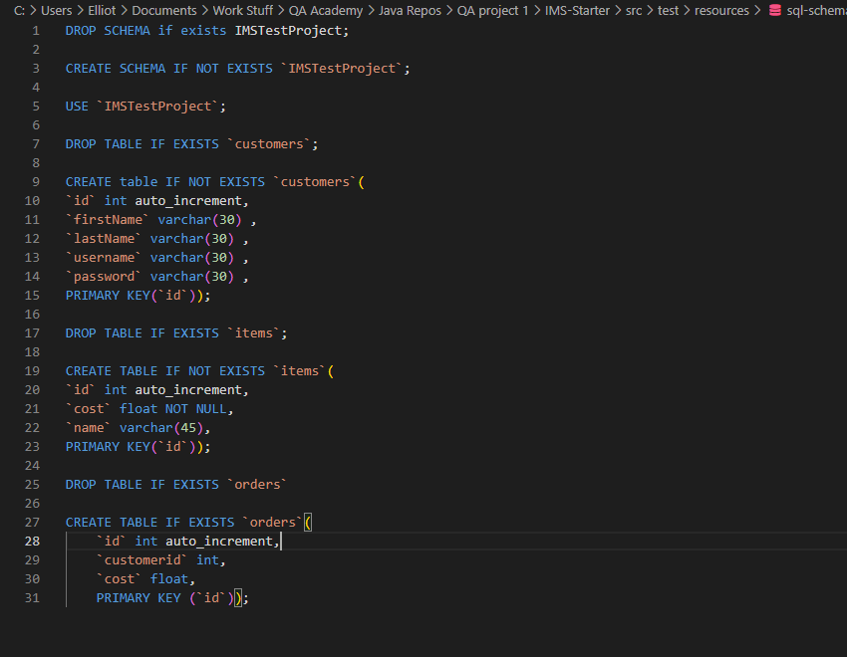
Testing - Schema

Slide 14
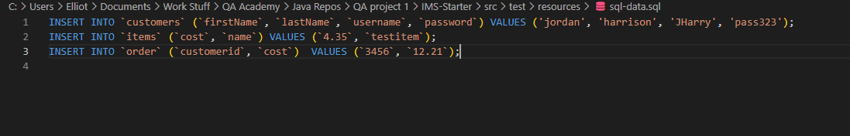
Testing – SQL Data

Slide 15
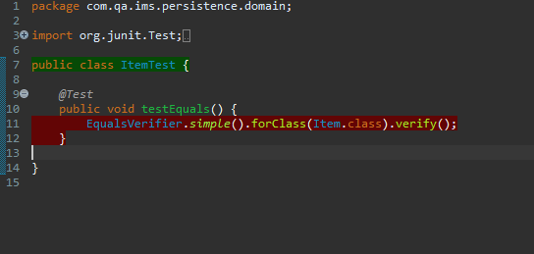
Testing - Object

Slide 16
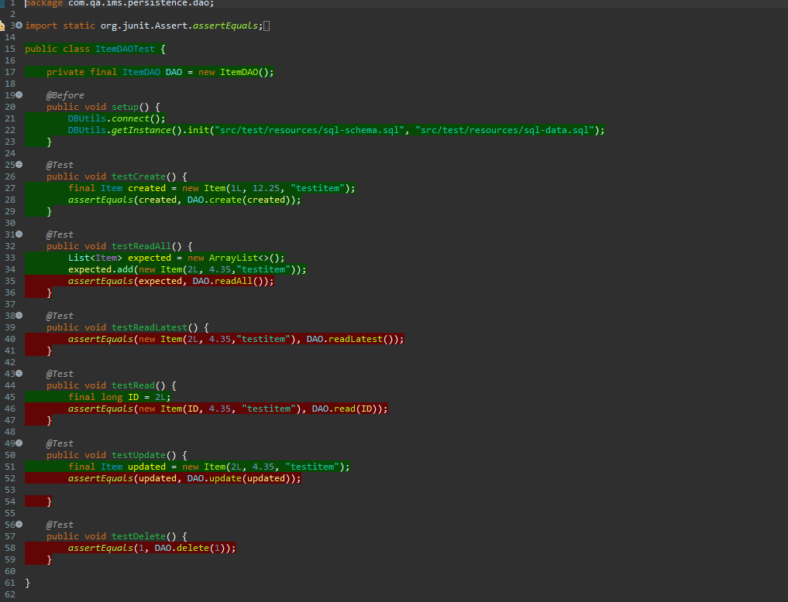
Testing - DAO

Slide 17
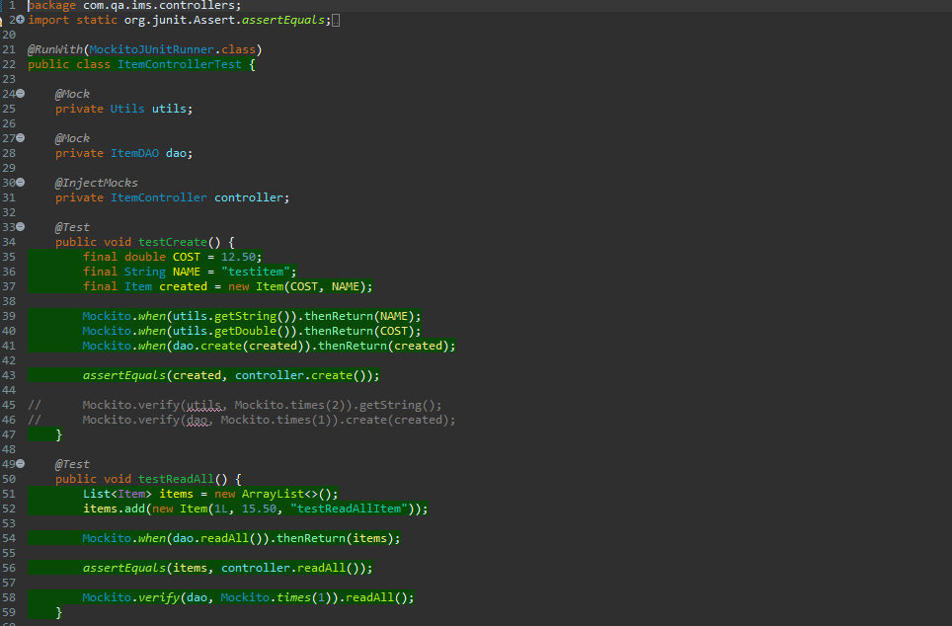
Testing - Controller

Slide 18
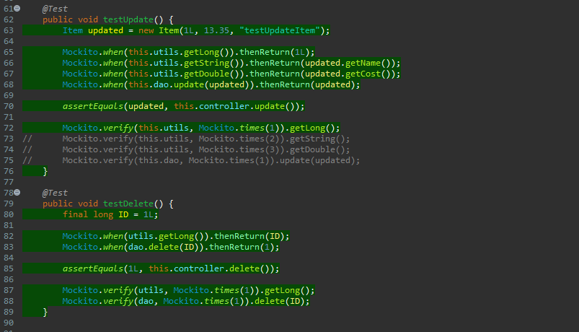
Testing - Controller

Slide 19
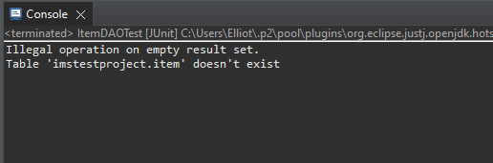
Debugging

Slide 20
To do
Finish debugging tests
Create readme
Maven Clean
Create JAR file

Slide 21
Mistakes
Spent too much time helping others early, and fell behind as a result
Didn’t build code focused on brief
Wasted time building classes for a flawed ERD, which later got scrapped
Multiple problems with git branching led to a lot of wasted time, which could have easily been avoided

